Slide 1

To-Do List Management System
Course: CS2053 – Java Programming
Team Members: Riddhi D Shah 1RUA24SCS0092
Saloni Yogesh Mavani 1RUA24SCS0098
Sriraksha R Hiremath 1RUA24SCS0113
Vaishnavi Goswami 1RUA24SCS0120
Instructor: Shrishty Kumari maam , K Sailaja Kumar maam
Date: November 2025

Slide 2






Project Overview: Building a Command-Line To-Do List
Our mission: To develop a robust, command-line based To-Do List application. This system empowers users to efficiently manage their daily tasks, offering functionalities to add, edit, delete, mark tasks as completed, and ensure data persistence.
Task Management
Flexible Viewing
Task Manipulation
Create tasks with detailed title, associated project, and specific due dates.
Organize and view tasks sorted by due date or grouped by project for clarity.
Easily edit task details, mark completion status, or remove tasks.
Data Persistence
Insightful Dashboard
Seamlessly save and load all task data using file serialization.
Get a quick summary of completed, pending, and overdue tasks at a glance.

Slide 3
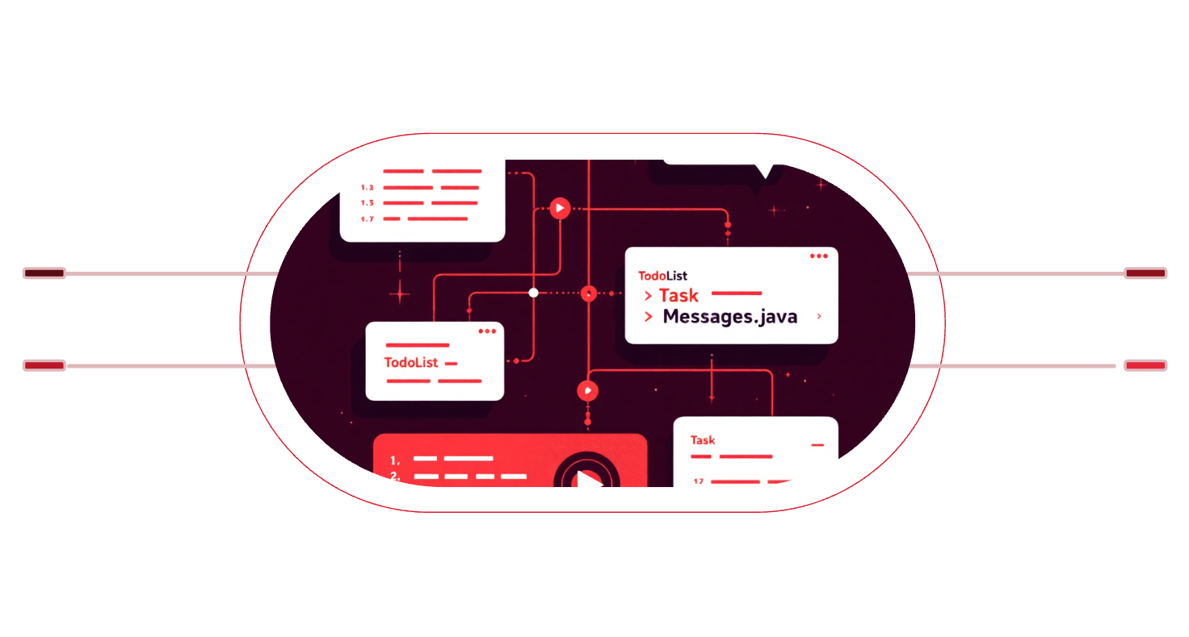


System Architecture: Deconstructing the Application
Our To-Do List application is built upon a clear and modular architecture, ensuring maintainability and scalability. Each component plays a distinct role in delivering a seamless user experience.
Main Components:
Data Flow:
Main.java – Orchestrates program flow, manages user input, and navigates menus.
TodoList.java – Encapsulates the core logic for all task data management.
User Input
Main
Commands entered by the user
Orchestrates flow and delegates actions
Task.java – Defines the structure and behavior of individual task objects.
TodoList
Messages.java
Manages collection of Task objects
Formats messages and sends to console
Messages.java – Dedicated to handling all console outputs, menus, and visual styling.

Slide 4


Class Spotlight: Task.java
The Task.java class is the fundamental building block of our application, representing a single to-do item with all its pertinent details.
Purpose:
To encapsulate the data and behavior of an individual task within the To-Do List system.
Attributes:
String title: A concise description of the task.
String project: The category or project the task belongs to.
LocalDate dueDate: The target completion date for the task.
boolean isComplete: A flag indicating whether the task has been finished.
Key Methods:
markCompleted(): Changes the isComplete status to true.
isOverdue(): Determines if the task's due date has passed without completion.
getDueDateString(): Returns the due date in a user-friendly, formatted string.

Slide 5







Class Spotlight: TodoList.java
The TodoList.java class serves as the central hub for managing the collection of all tasks, providing methods for their creation, manipulation, and persistence.
readTaskFromUser()
listAllTasks(String sortBy)
editTask(String selectedTask)
Facilitates the creation of new tasks by gathering input directly from the console.
Displays tasks in a clear, organized manner, with options to sort by various criteria.
Allows users to modify existing task details or remove tasks from the list.
saveToFile() / readFromFile()
Summary Counts
Manages the persistent storage and retrieval of task data to and from a file.
completedCount(), notCompletedCount(), overdueCount() provide immediate task summaries.

Slide 6

Class Spotlight: Messages.java
The Messages.java class is dedicated to enhancing the user experience by managing all console outputs, providing clear instructions, and visually distinguishing information.
Color-Coded Output
Green for success messages and Red for error alerts, improving readability and user feedback.
Interactive Menus
Clear and intuitive displays for the Main Menu, Edit Options, and Task List, guiding users through the application.
showDashboard()
Presents a visually engaging summary of task progress, including counts and an ASCII progress bar.
showOverdueSummary()
Alerts the user to any overdue tasks, ensuring critical items are not overlooked.

Slide 7

Program Flow: A Step-by-Step Execution
The application follows a logical sequence of operations, starting from initialization to user interaction and data persistence.
Program Initialization
1
The application begins execution with Main.java taking control.
2
Load Existing Tasks
The system attempts to load previously saved tasks from the tasks.obj file using readFromFile().
Display Dashboard & Menu
3
Users are presented with an overview dashboard and the main interactive menu.
4
User Interaction Loop
The application enters a loop, awaiting user input to perform actions like viewing, adding, or editing tasks.
Save and Exit
5
Upon user exit, all changes are saved back to the tasks.obj file, ensuring data integrity.

Slide 8



Data Persistence: Reliable Task Storage
Ensuring that user data is saved and retrieved reliably is crucial for any application.
Our To-Do List achieves this through Java's built-in Object Serialization.
How Data is Saved:
Utilizes Object Serialization via ObjectOutputStream and ObjectInputStream.
All task objects are written to and read from a binary file named tasks.obj.
Data is automatically loaded upon application startup and saved upon graceful exit.
Advantages:
This approach offers a simple and highly reliable method for data storage, eliminating the need for complex external databases for a command-line application.

Slide 9





Enhanced Features: Beyond the Basics
We've integrated several advanced features to make the To-Do List application more user-friendly and robust.
Enhanced Dashboard
Visual display of Completed, Pending, and Overdue task counts, complemented by an engaging ASCII progress bar.
Overdue Tracking
Automatic monitoring of due dates with proactive warnings for any tasks that have become overdue.
Optional Due Dates
Users have the flexibility to omit due date input if a task doesn't require a specific deadline.
Error Handling & Validation
Robust checks for invalid inputs, such as incorrect date formats, ensuring a smooth and resilient user experience.

Slide 10


Conclusion & Future Scope
This project stands as a testament to our understanding and application of core Java programming principles.
Conclusion:
Future Improvements:
The To-Do List Management System successfully showcases effective implementation of Java Object-Oriented Programming (OOP) concepts, robust file handling for data persistence, comprehensive exception management, and intuitive command-line user interaction.
GUI Version: Develop a more visual interface using JavaFX or Swing.
Category Filtering: Implement advanced filtering options for tasks based on categories or tags.
Notifications: Add reminders and notifications for upcoming or overdue tasks.
Thank You! Any Questions?
Cloud Integration: Explore integration with cloud services or external databases for multi-device access.

